Slide 1
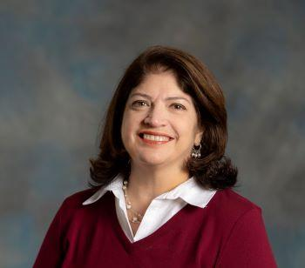


Office of Graduate Student Life
The Office of Graduate Student Life aims to provide graduate and professional students with an engaging, supportive, and inclusive graduate student experience from entry to graduation. We foster community, sense of belonging, and help students navigate the vast array of resources available at Rutgers.
Ghada Endick, Assistant Dean
Navigating Resources Graduate Student Programming
Making Connections Building Community
FOLLOW US!
RUgradstudentlife
VISIT US ONLINE!
graduatestudentlife.rutgers.edu
Kelly Martini, Assistant Director

Slide 2
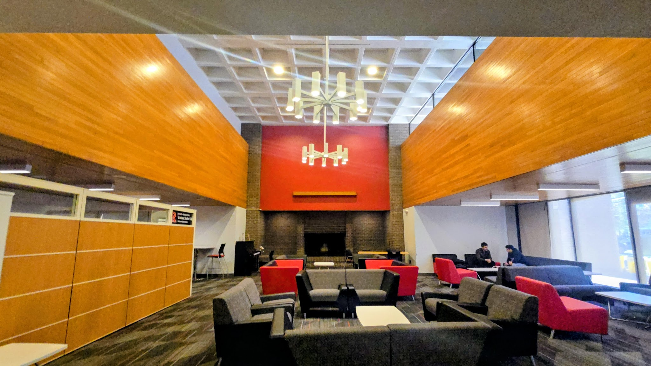
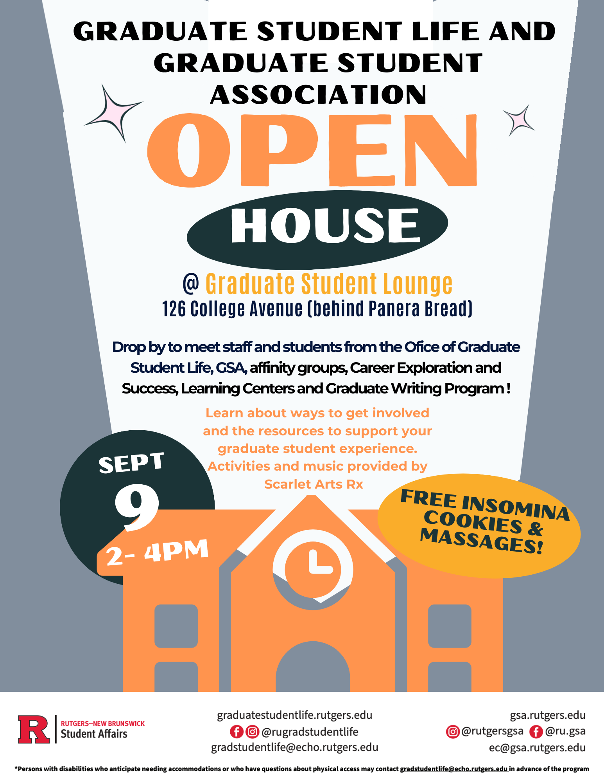
VISIT US
The Graduate Student Lounge is part of the College Ave. Student Center, located at 126 College Ave. The entrance faces Morrell Street, right behind Panera.
Study or hang out between classes!
Microwave
Complimentary coffee and tea
Lending library
Office of Graduate Student Life
Stop by the Graduate Student Lounge from on September 8 from 2-4pm to learn more about graduate student resources! Giveaway for first 50 students.

Slide 3


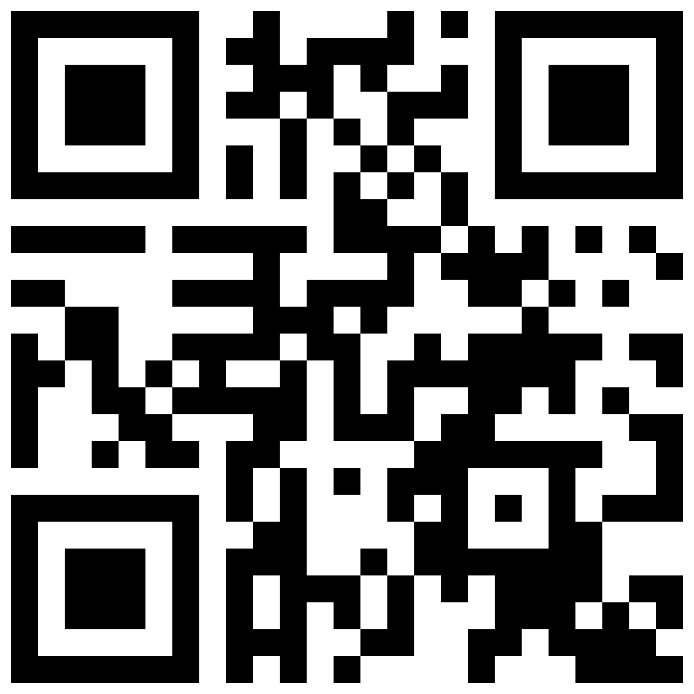
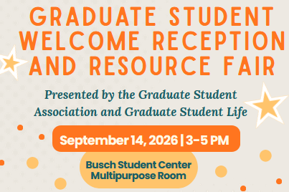
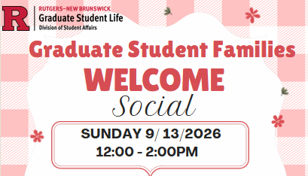
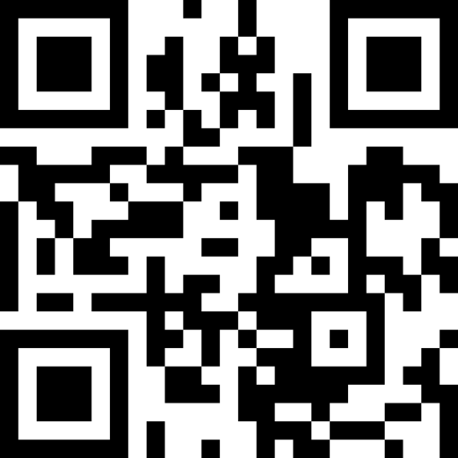

STAY INFORMED!
The Graduate Student Life Weekly Digest provides weekly updates on events, programs, employment opportunities, and student support resources available to graduate students at Rutgers!
Scan or click HERE to subscribe to the Weekly Digest!
Scan or click HERE to follow us on Instagram @rugradstudentlife!

Slide 4

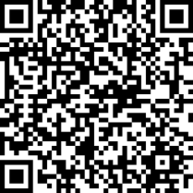
Upcoming Programs & Events!
First Weeks @ Rutgers: Welcome Programs
Fall 2026
All incoming and continuing graduate students are invited to participate in welcome and community-building programs to kick off the initial weeks of the Fall semester. Programs are designed to introduce you to essential resources, provide opportunities to connect with other graduate students, learn about Graduate Student Organizations and participate in campus-wide events. There are graduate-exclusive programs and university events open for both undergraduate and graduate students.
Check out the full schedule of events
for Fall 2026 on our website!
(go.rutgers.edu/firstweeks26)
Exclusive Events for Graduate Students!
Community & Belonging & Affinity-Based Programs!
Fitness and Wellness Activities
University-Wide Social Events
Community Engagement Events
… And More!

Slide 5

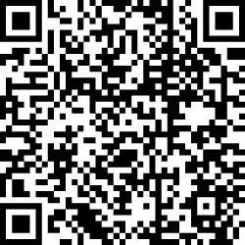
Upcoming Programs & Events!
Graduate Student Welcome Reception & Resource Fair
All graduate Students are invited to join the Office of Graduate Student Life and Graduate Student Association (GSA) to enjoy food and networking while engaging with Graduate Student Organizations and University Departments that provide support services and resources for graduate students!
Monday, September 14
3:00pm - 5:00pm
Busch Student Center
Multipurpose Room
Scan the QR Code
or RSVP online!

Slide 6
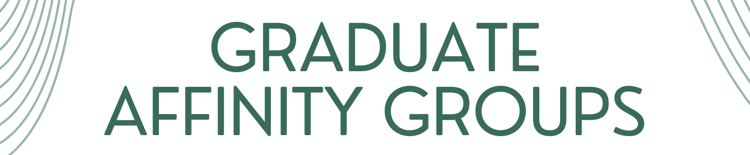
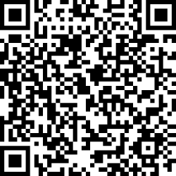
Finding Your Community
Graduate Affinity Groups
Interested in joining a peer-led group with other students who share similar backgrounds, social identities, and experiences?
Graduate affinity groups are a great way to build community with peers. Register by September 4 to receive info about the Fall 2026 Welcome Gatherings!
Click HERE or scan QR code to register!
NINE Peer-led Graduate Affinity Groups:
African Graduate Student Group
BIPOC LGBTQIA2S+ Graduate Student Group
Caribbean Graduate Student Group
Chinese Graduate Student Group
Latino/a/e/x Graduate Student Group
Multicultural Graduate Students (Third Culture)
RU International Graduate Students (RINGS)
Supporting Neurodiversity at Rutgers
Southeast Asian Graduate Student Group (SEA)

Slide 7

Finding Your Community
Graduate Student Socials @ the Cultural Centers
LGBTQIA2S+ Grad Student Welcome
Wednesday, September 9, 5:00pm – 7:00pm
Location: Center for Social Justice Education and LGBT Communities (17 Bartlett St., College Ave. Campus)
Join us at SJE to mingle, connect, and enjoy good food and music while in community with your fellow master's and doctoral peers.
PRCC & Council of Black Graduates Graduate Student Mixer – Tuesday, September 15, 6:00pm - 7:30pm
Location: The Rutgers Club
(85 Avenue E., Livingston Campus)
CBG welcomes all Black-identified grad students to connect with other Black grads over free refreshments and lots of camaraderie.
Asian, Pacific Islander, Desi, and Arab (APIDA) Grad Student Paint & Sip – Tuesday, September 22, 1:00pm – 2:00pm
Location: Asian American Cultural Center
(49 Joyce Kilmer Ave., Piscataway, Livingston Campus)
Join your fellow grad students at the Asian American Cultural Center to enjoy
amazing cultural food, mocktails, and giveaways. This is a paint and sip!

Slide 8
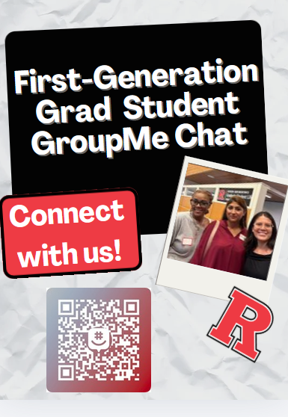


Programming for First-Generation Graduate Students
Visit the First-Gen Grads webpage:
https://go.rutgers.edu/firstgrads

Slide 9
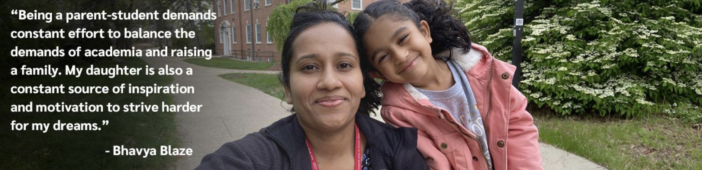

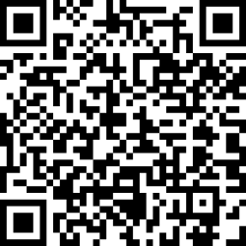
Support for Pregnant and Parenting Graduate Students
National Student Parent Month
Every September, the Office of Graduate Student Life celebrates our Graduate Parenting Students for National Student Parent Month. This month of programming is dedicated to recognizing the importance of empowering student parents as they balance the demands of academics and family life; raise awareness about the unique challenges they face; and provide opportunities to learn about resources and connect with other graduate student parents.
Resource Webpage for Pregnant and Parenting Graduate Students!
Check out the new resource webpage for pregnant and parenting graduate students for information about support services, resources, policies, and community engagement opportunities that are available to pregnant and parenting students at Rutgers.
Learn more about National Student Parent Month at RU:
go.rutgers.edu/nspm26
View the Resource Webpage for Pregnant and Parenting Graduate Students:
go.rutgers.edu/gradparents

Slide 10
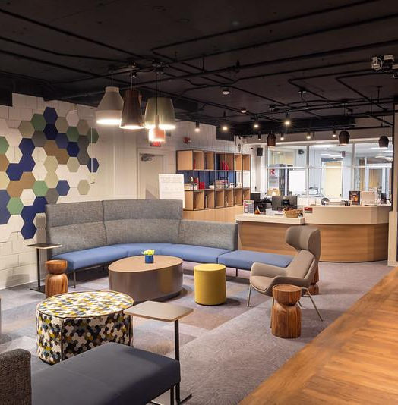
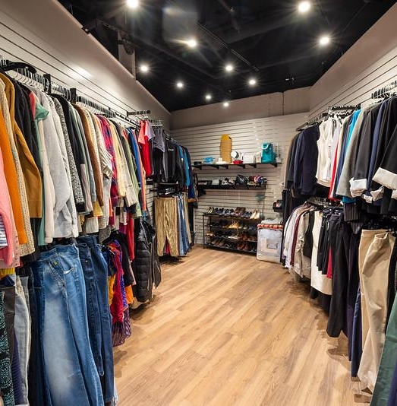
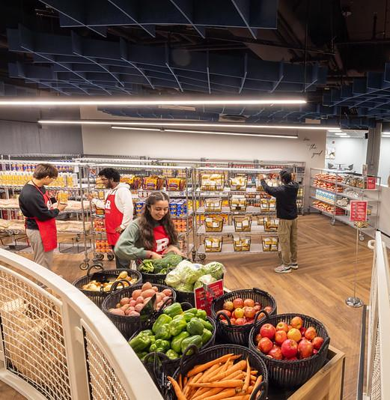
Student Basic Needs
Student Basic Needs
RU Student Basic Needs provides support for basic needs including but not limited to food, housing, clothing, childcare, mental health, financial resources, and transportation
More Information: basicneeds.rutgers.edu
Make an appointment with Student Basic Needs by emailing: basicneeds@echo.rutgers.edu
Basic Needs Center
Located in College Ave Student Center Room 112
(126 College Ave, New Brunswick, College Ave Campus)
Streamlined one-stop access to resources and services to ensure all students have their basic needs including:
Food Pantry
Fresh & non-perishable foods, hygiene products, and diapers. Pantry on College Ave, Mobile Food Pantry, and after-hours pantry lockers available.
SNAP Counseling
In-person and online appointments offering SNAP counseling and other resource screenings.
Clothing Closet
Professional and casual attire available.
Textbook Loaner Program
Borrow available textbooks for free
More Information about the Basic Needs Center
can be found on the Basic Needs webpage.
Follow Basic Needs!
RUbasicneeds

Slide 11
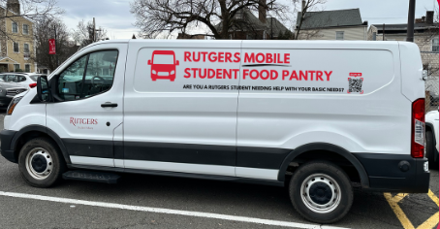

Student Basic Needs
Follow Basic Needs!
RUbasicneeds
Food Resources
Rutgers Food Pantry
The Rutgers Student Food Pantry is dedicated to helping all Rutgers students in need of food. Students can visit the Pantry in the College Avenue Student Center and receive about one week’s worth of groceries, no questions asked.
Rutgers Mobile Food Pantry
Can’t make it to College Ave? The Rutgers Mobile Food Pantry makes stops in Downtown New Brunswick, Douglass, Busch, and Livingston.
After Hours Knights Pantry Basic Needs Box
Not able to make it to the food pantry during normal operating hours? Non-perishable items can be ordered in advance and picked up from a locker after hours.
More Information including operating hours and locations can be found HERE.
The Rutgers Emergency Aid Fund provides RU-NB students with one-time need-based financial support for unforeseen, unavoidable, unplanned costs associated with emergencies like accidents, illnesses, fire and water damage, or the need for emergency housing and food. Learn more HERE.

Slide 12

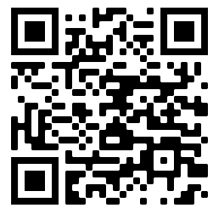
GRADUATE STUDENT ASSOCIATION
Contact GSA
The GSA is the official graduate student governing body of the Rutgers New Brunswick/Piscataway campus.
The mission of the GSA is to further graduate student interests, graduate student-University relations, and the social, cultural, and academic enrichment of graduate students at Rutgers.
  75+ graduate student organizations
  Grad-University relations
The Graduate Student Lounge (GSL) is the headquarters for the GSA. It is located on the
College Avenue Campus next to the Rutgers
Student Center behind Panera Bread. Stop by
to study, relax, seek GSA assistance, or attend
an event.
SUPPORT
  Public service
  Mental/Physical Wellness
  Grad life
ADVOCACY
  Between RU grads
  Intercollegiate
  National orgs
Join the GSA’s mailing list to get involved!
COMMUNITY
GSA Office
Graduate Student Lounge, 207A
126 College Avenue
New Brunswick, NJ 08901
President
Victoria Brown
president@gsa.rutgers.edu

Slide 13
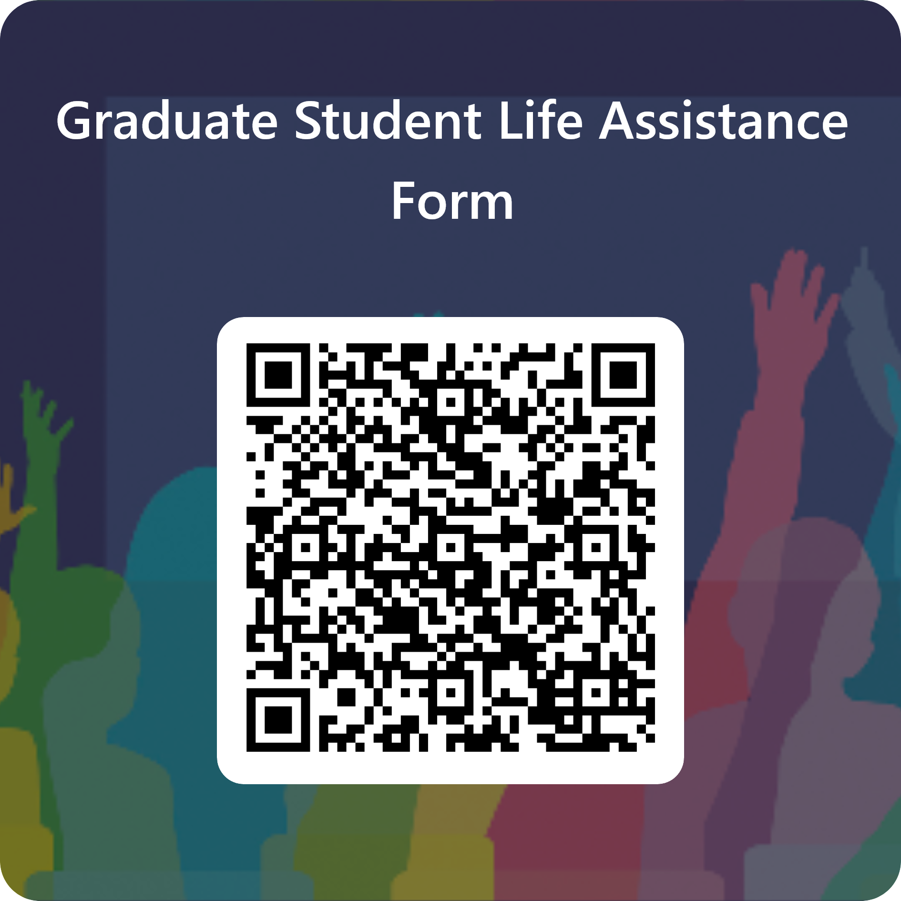
Have questions or
having trouble finding support?
Contact the Office of Graduate Student Life
for assistance!

